Slide 1
HBKU Innovation Directorate
Innovation Center – Expertise Catalog V1.
October 25, 2021
Nadir Yıldırım, PhD
Innovation Director
www.hbku.edu.qa

Slide 2
HBKU INNOVATION CENTER (IC) – EXPERTISE CATALOG
Hamad Bin Khalifa University (HBKU) Expertise Catalog (EC)
The HBKU EC was designed and developed to provide easiness, agility, and the professionality for sustainable and diversified collaboration with our stakeholders.
The HBKU EC includes 8 Themes and 170 Sub-themes for visitors’ use. The system allows visitors to filter their search by themes, sub-themes, a-z, or just through a basic search bar.
The overall goal is to make our intellectual knowledge and experience reachable for interested parties in seconds.
Looking forward to collaborating with stakeholders for an innovation based smart and sustainable future..

Slide 3
HBKU EXPERTISE CATALOG
EXPERTISE CATALOG DESIGN AND DEVELOPMENT PROCESS (Phase I)
Step # | Activity | Anticipated Timeline of Activities - 2021 |  |  |  |  |  |  |  |  | 2022 | Collaborating Parties
Step # | Step Title | Apr | May | Jun | Jul | Aug | Sep | Oct | Nov | Dec | Jan | Collaborating Parties
1 | Suggestions from Deans and RI Directors |  |  |  |  |  |  |  |  |  |  | RIs-Colleges-IC
2 | Preparation of Expertise Catalog V1 |  |  |  |  |  |  |  |  |  |  | IC
3 | Collection of feedback from Deans and RI Direc. |  |  |  |  |  |  |  |  |  |  | RIs-Colleges-IC
 | 3.1. Review of Themes and Sub-themes
 | 3.2. Collection of Expert Full Information
4 | Having Meeting with Communication |  |  |  |  |  |  |  |  |  |  | IC – HBKU Comm.
5 | Demo of Online Expertise Catalog |  |  |  |  |  |  |  |  |  |  | HBKU Comm.
6 | Dr. Hasnah’s Feedback |  |  |  |  |  |  |  |  |  |  | IC
7 | Enhancement, Finalization and Final Approval |  |  |  |  |  |  |  |  |  |  | IC – HBKU Comm.
8 | Online Publishment of HBKU Expertise Catalog |  |  |  |  |  |  |  |  |  |  | IC – HBKU Comm.
Green color represents completed activity, yellow color represents active step, gray color represents following steps.

Slide 4
HBKU EXPERTISE CATALOG
Hamad Bin Khalifa University (HBKU) Expertise Catalog (EC)
See all
Themes
Sub-themes
A – B – C – D – E – F – G – H – I – J – K – L – M – N – O – P – Q – R – S – T – U – V – W – X – Y – Z
Search:
COMPUTING
ENERGY, WATER AND ENVIRONMENT
HEALTH & LIFE SCIENCES
INNOVATION & ENTREPRENEURSHIP
HUMANITIES & SOCIAL SCIENCES
ISLAMIC STUDIES
LAW
POLICY
PLEASE SEE EXCEL FILE # 1 FOR FULL LIST OF THEMES AND SUB-THEMES

Slide 5
Hamad Bin Khalifa University (HBKU) Expertise Catalog (EC)
See all
Themes
Sub-themes
A – B – C – D – E – F – G – H – I – J – K – L – M – N – O – P – Q – R – S – T – U – V – W – X – Y – Z
Search:
Active Ageing
Analytics and Decision Support
Anatomy
Functional Anatomy
Applied Islamic Ethics
Arabic Language Culture, Heritage, & Technologies
Artificial Intelligence
Audio-visual and Media Translation
Biomechanics
Bioinformatic
Big Data Analytics
Biostatistics
Business & Commercial Law
Cancer Biology
Cancer Biomarkers and Therapy
Cancer Immunology and Immunotherapy
Cardiorespiratory Physiology
Cardiovascular Diseases
Cell and Molecular Biology
Cellular Structures
Clean Energy
Climate Change
Clinical and Exercise Epidemiology
Clinical Exercise Physiology
Comparative Religion
Constitutional Law
Criminal Law
CRISPR Technology in Gene Editing and SARS-CoV-2 detection
Cybersecurity
Data Analytics
Diabetes
Drone Technologies
Drug Discovery
PLEASE SEE EXCEL FILE # 1 FOR FULL 170 SUB-THEMES
Entrepreneurship
Environmental Protection & Restoration
Epidemiology and Genetics of Autism
Globalized Curriculum
Health Care Law
Health Promotion
Islam & Global Affairs
Language and Linguistics
Law Technology and Intellectual Property
Logistics and Supply Chain Management
Machine Learning
Multisensory Communication
National Health Mapping Programs
Neurodevelopmental and Neurodegenerative Disorders
Neurological Disorders
News and Social Media Analytics
Organizational Design
Outcomes Research
Personalized Medicine and Healthcare
Pharmacogenomics
Policy Analysis and Policy Design
Political Economy
Preventive Health
Program Evaluation
Protein Structure and Function
Proteomic
Quantum Computing
Resource Security & Management
Risk Prediction
Sensors, Communications and Networking
Smart Economy
Smart Cities
Smart Society
Social Computing
Social Emotional & Character Development
Social Inclusion
Social Media and Knowledge Production and Dissemination
Social Responsibility
Sport Physiology
Sustainable / Circular Economy
Sustainable Development Goals
Sustainable Energy
Transcriptomic
Validation of Educational Tests
Water Security
Women and Gender in the Middle-East
Wellbeing
Youth Policy

Slide 6
HBKU EXPERTISE CATALOG
Hamad Bin Khalifa University (HBKU) Expertise Catalog (EC)
See all
Themes
Sub-themes
A – B – C – D – E – F – G – H – I – J – K – L – M – N – O – P – Q – R – S – T – U – V – W – X – Y – Z
Search:
COMPUTING
ENERGY, WATER AND ENVIRONMENT
HEALTH & LIFE SCIENCES
INNOVATION & ENTREPRENEURSHIP
HUMANITIES & SOCIAL SCIENCES
ISLAMIC STUDIES
LAW
POLICY
Business & Commercial Law
Constitutional Law
Criminal Law
Energy and Environmental Law
Health Care Law
International Law
Law Technology and Intellectual Property

Slide 7
HBKU EXPERTISE CATALOG
Hamad Bin Khalifa University (HBKU) Expertise Catalog (EC)
See all
Themes
Sub-themes
A – B – C – D – E – F – G – H – I – J – K – L – M – N – O – P – Q – R – S – T – U – V – W – X – Y – Z
Search:
COMPUTING
ENERGY, WATER AND ENVIRONMENT
HEALTH & LIFE SCIENCES
INNOVATION & ENTREPRENEURSHIP
HUMANITIES & SOCIAL SCIENCES
ISLAMIC STUDIES
LAW
POLICY
Business & Commercial Law
Constitutional Law
Criminal Law
Energy and Environmental Law
Health Care Law
International Law
Law Technology and Intellectual Property

Slide 8




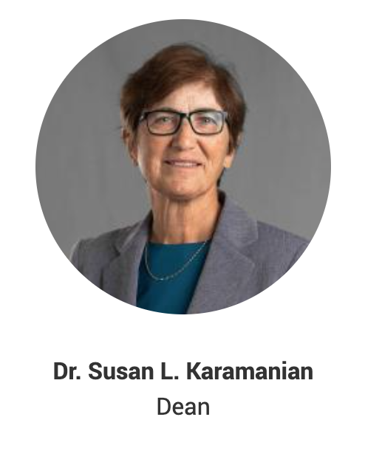
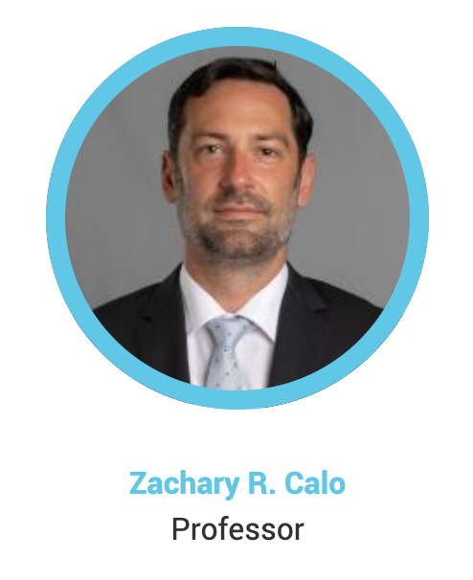
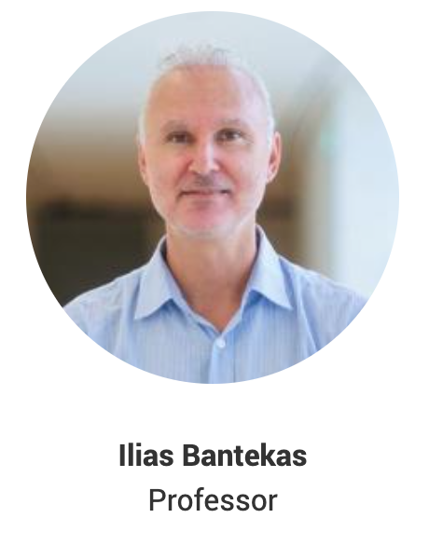
HBKU EXPERTISE CATALOG
Hamad Bin Khalifa University (HBKU) Expertise Catalog (EC)
See all
Themes
Sub-themes
A – B – C – D – E – F – G – H – I – J – K – L – M – N – O – P – Q – R – S – T – U – V – W – X – Y – Z
Search:
COMPUTING
ENERGY, WATER AND ENVIRONMENT
HEALTH & LIFE SCIENCES
INNOVATION & ENTREPRENEURSHIP
HUMANITIES & SOCIAL SCIENCES
ISLAMIC STUDIES
LAW
POLICY
Business & Commercial Law
Constitutional Law
PLEASE SEE EXCEL FILE # 2 FOR FULL LIST OF EXPERTS BASED ON EXPERTISE AREAS
Please click on Dr. Zachary R. Calo’s photo to connect his personal webpage under HBKU. This is the way EC system will work.

Slide 9
HBKU EXPERTISE CATALOG
Next Steps
Design and development of online demo to get Dr. Hasnah’s Feedback and Suggestions.
Revisions based on any content change/update requests from RIs and Colleges.
Enhancement, finalization and Final feedback from Dr. Hasnah.
Online Publication.

Slide 10
HBKU EXPERTISE CATALOG
Notes:
The same sub-theme can be located under different Themes
The same expert can be located under different sub-themes based on his/her expertise areas.
Ex 1. The ‘Social Computing’ sub-theme might already be covering the ‘News and Social Media Analytics’ sub-theme. However; The ‘News and Social Media Analytics’ sub-theme is a hot topic and should be easily found in seconds. Or the stakeholder who is looking for collaboration or consultancy support on ‘News and Social Media Analytics’ might not be well aware that it can be found under ‘Social Computing’ sub-theme.

Slide 11
HBKU EXPERTISE CATALOG
Following Steps for 2022 (Phase II)
Automated System. An individual enrollment and leave option needs to be designed, developed and integrated for the following term.
The overall goal is to update the expertise catalog through the enrollment and leave system by the joiners and leavers.
Ex 1. Once a new faculty member joins to HBKU, he/she will fill out and submit an online form includes his/her Theme (s), Sub-theme (s) and Personal Webpage Link information.
Ex 2. Once a current faculty member leaves, he/she will fill out and submit the one-page online form where he/she states his/her leave.
The models and methods are open for discussion. Nothing to worry about for now (Phase I).

Slide 12
شكرًا
THANK YOU
Nadir Yıldırım, PhD
Innovation Director
www.hbku.edu.qa

